Slide 1
Office 365 Development

Slide 2
Deep dive into the Office 365 Groups API

Slide 3















Vision
EXTEND OFFICE EVERYWHERE
CONNECT TO OFFICE 365 SERVICES
BUILD USING AN OPEN PLATFORM
Delve
z
Users and groups
Files
Mail
Calendar
My Apps
Video Portal
Contacts
Office Graph
Presentations
Documents
Spreadsheets
Lync
OneNote
Yammer

Slide 4

Agenda
Understanding Groups
Extensibility
Groups API
Coming Soon

Slide 5
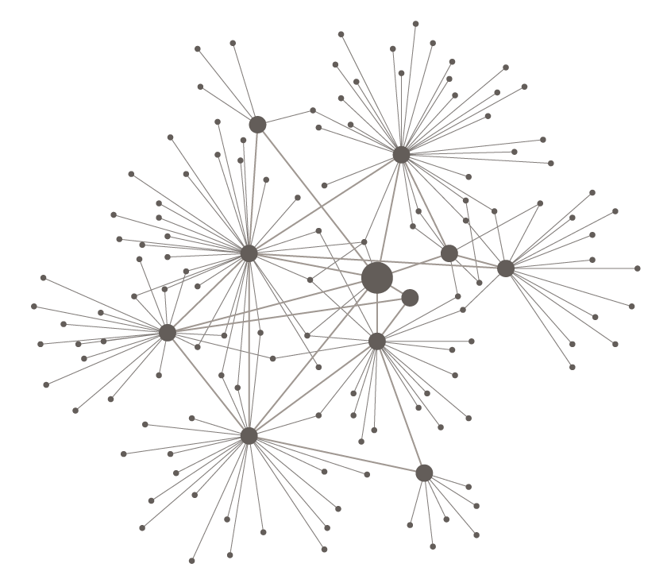
TRADITIONAL HIERARCHIES
RESPONSIVE NETWORKS
INFORMATION MOVES SLOWLY COMMAND AND CONTROL
INFORMATION TRAVELS FAST LEARN AND ADAPT

Slide 6
TRADITIONAL HIERARCHIES
RESPONSIVE NETWORKS
FIXED WORKFORCES SILOED TEAMS
LEVERAGE THE ON-DEMAND GLOBAL TALENT POOL

Slide 7

THE RISE OF DYNAMIC TEAMS
MODERN COLLABORATION
INTELLIGENT FABRIC
PERSONALIZED INSIGHT

Slide 8

Introducing Office 365 Groups
Brings together people, information, and apps across Office 365, to enable better communication and collaboration.

Slide 9
Office 365 Groups helps teams self-organize, work together across any tool of their choice and build upon the expertise of others, it's a key part of our vision for modern collaboration. The Office 365 Groups service creates a standard definition for team membership across Exchange, OneDrive, and later Yammer, Skype for Business and the rest of Office 365, managed thru Azure Active Directory.

Slide 10
Introducing Office 365 Groups
Brings together people, information, and apps across Office 365, to enable better communication and collaboration.

Slide 11
Key Benefits of Groups
Single definition
Public by default
Sharing to non-members
Self-service
Context & history
Simple to manage

Slide 12





Groups building blocks
Office 365 Groups
Azure
Active Directory
Outlook
OneDrive
OneNote
Calendar
Skype
Dynamics CRM
Delve
Yammer
…
Apps

Slide 13
One group system across Office 365
One identity
Azure Active Directory (AAD) is the master for group identity and membership across Office 365 (Exchange, SharePoint, etc.)
Federated resources
O365 services extend with their data (e.g., conversations stored in Exchange mailbox & documents stored in OneDrive for a group)
Loose coupling
Services notify each other of changes to a group (e.g., creation, deletion, updates)
Using sync from AAD to Exchange Online AD and SharePoint Online AD they achieve reliability if they miss notifications
Exchange
Group mailbox
Exchange Online AD
Conversations
Calendar
AAD
SharePoint
Group identity
OneDrive for business
SharePoint Online AD
Documents
OneNote
Identity
Resource URLs
Owners
Members
Additional workloads
Workload resources
Local
directory
Workload scenarios

Slide 14
demo
Exploring Groups

Slide 15
Extensibility

Slide 16
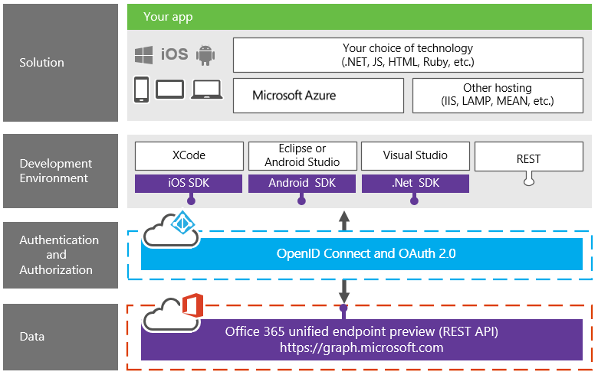
Office 365 platform overview

Slide 17
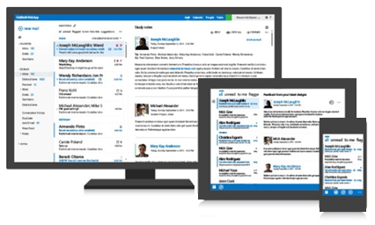
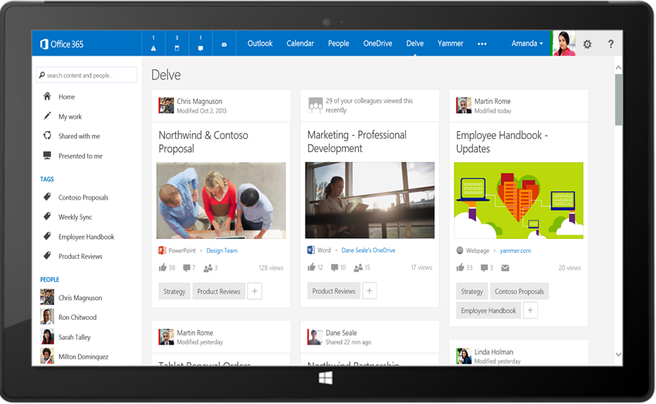
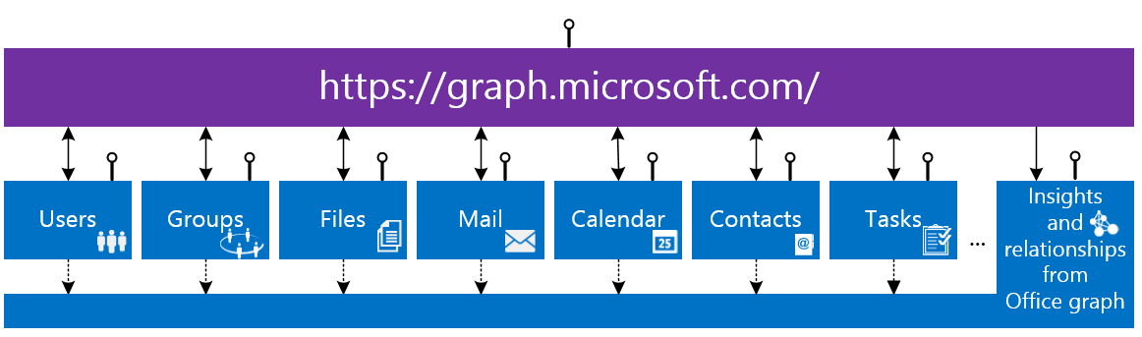
Office 365 unified API (preview)
Your App
https://graph.microsoft.com/

Slide 18
demo
Create Azure AD Applications for the Groups API

Slide 19
https://graph.microsoft.com/beta/myorganization/groups?$filter=groupType+eq+'Unified'
MANAGEMENT
/CONVERSATIONS
/EVENTS
/FILES

Slide 20
Building your app
Register app in Azure portal
Native
Web app
Single page app
Configure app permissions
Groups.Read.All
Groups.ReadWrite.All
Get token using OAuth2.0 flow
Use OpenID Connect for SSO
Build your code using O365 unified API

Slide 21
Groups management (preview)
Entities, collections, and actions
Samples
https://graph.microsoft.com/beta/contoso.com/groups/{id}/
https://graph.microsoft.com/beta/contoso.com/groups/{id}/AddFavorite
ENTITY | COLLECTION | ACTIONS
Group | Groups | CRUD SubscribeByMail, UnsubscribeMyMail, AddFavorite, RemoveFavorite, ResetUnseenCount
User/Me | Users | JoinedGroups
Collection
Action

Slide 22
Groups content: Conversations
Blah
lol
ttyl
Entities, collections, and actions
Samples
https://graph.microsoft.com/beta/contoso.com/groups/{id}/conversations
https://graph.microsoft.com/beta/contoso.com/groups/{id}/threads/{id}/reply
ENTITY | COLLECTION | ACTIONS
Conversation | Conversations | Create, read, and delete
Thread | Threads | Reply
Post | Posts | Reply, forward
Attachment | Attachments | CRUD

Slide 23
Groups content: Calendar
Entities, collections, and actions
Samples
https://graph.microsoft.com/beta/contoso.com/groups/{id}/events
../calendarview?startdatetime=2015-04-01 & enddatetime=2015-04-30
ENTITY | COLLECTION | ACTIONS
Calendar |  | Read
Event | Events | CRUD
Calendar view | N/A | Read
Attachment | Attachments | CRUD
Collection
No client-side recurrence expansion required ☺

Slide 24
Groups content: Files
Entities, collections, and actions
Samples
https://graph.microsoft.com/beta/contoso.com/groups/{id}/files
https://graph.microsoft.com/beta/contoso.com/groups/{id}/files/{id}/
ENTITY | COLLECTION | ACTIONS
File | Files | CRUD, upload, download
Folder |  | CRUD, enumerate children

Slide 25
Common content queries
SCENARIO | URL
Get top 10 conversations sorted by LastDeliveryTime | /group/{id}/conversations?$top=10&$orderby=LastDeliveryTime
Get the next 10 conversations | /group/{id}/conversations?$top=10&$skip=10
Get selected properties on events starting after a particular Date/Time | /group/{id}/events?$top=10&$select=Subject,Start,End&$filter=Start ge 2014-09-22
Get selected properties on conversation threads | /groups/{id}/conversations/{id}/threads/{id}/posts?$select=body
Get files where the name starts with “c” | /group/{id}/files?$filter=startswith(name,+'c')
Get selected properties on files | /group/{id}/files?$select=dateTimeCreated

Slide 26
demo
Groups API

Slide 27
Coming Soon

Slide 28
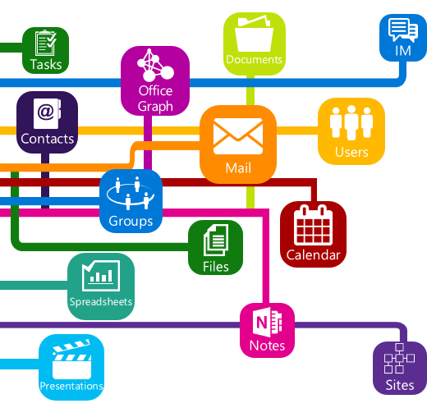
Roadmap
Files & pages
Invite guest users
Dynamics CRM
Extensible to third party apps
eDiscovery & legal hold
Data Loss Prevention
Azure Active Directory Connect
Instant-on provisioning
Notifications
Get/Set Group photo
Full-text search
Batching
Notes

Slide 29
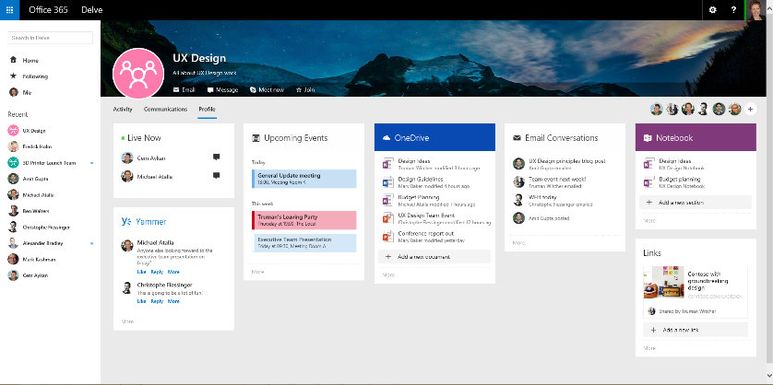
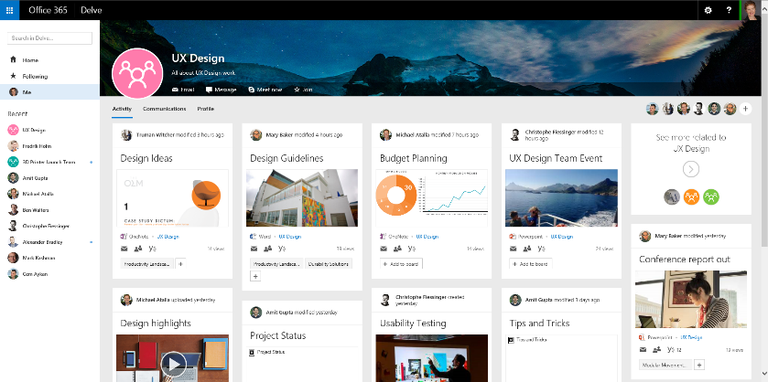
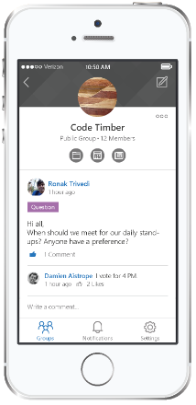
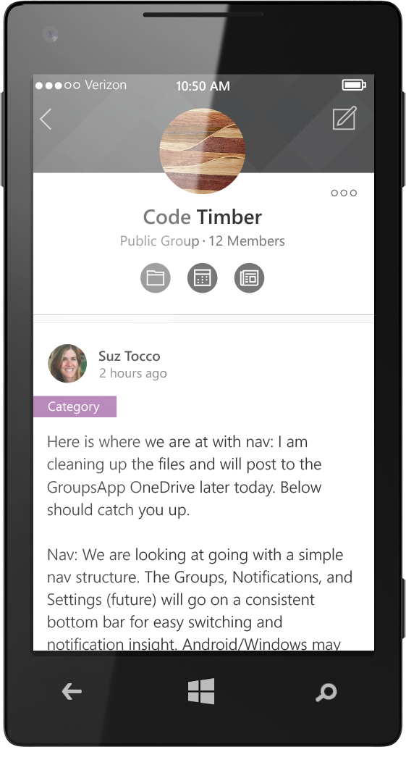
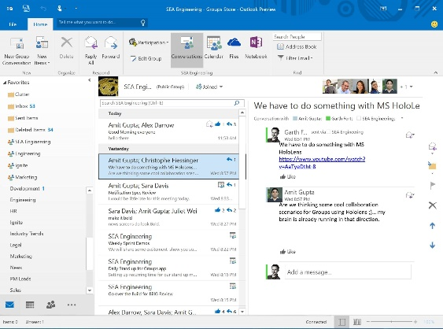
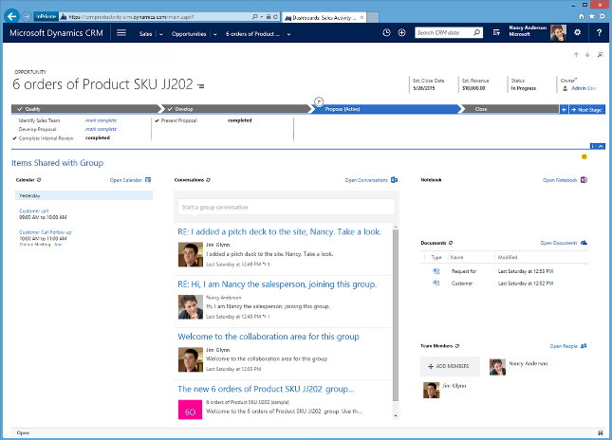
Up next in 2015
EXPERIENCES
ADMINISTRATION
EXTENSIBILITY
Outlook 2016 & mobile app
Office Graph & Delve integration
Skype Meet now
Files & pages
Invite guest users
Dynamics CRM
Extensible to third party apps
eDiscovery & legal hold
Data Loss Prevention
Soft-delete & restore
GAL activity monitoring
Expire inactive groups
Azure Active Directory Connect
Additional AAD improvements
Instant-on provisioning
Notifications
Get/Set Group photo
Full-text search
Batching
Notes

Slide 30
Groups Resources
Documentation
http://aka.ms/O365g
Questions
http://aka.ms/O365ng
Feedback
http://aka.ms/O365uv
Roadmap
http://roadmap.office.com

Slide 31
Summary
Understanding Groups
Extensibility
Groups API
Coming Soon

Slide 32



dev.office.com
Sign up
http://dev.office.com/getting-started
Explore
http://apisandbox.msdn.microsoft.com
Get trained http://dev.office.com/training

Slide 33


Feedback
Office 365 Network Share you best practices and join conversations https://www.yammer.com/itpronetwork
Stackoverflow Ask deep technical questions to a world-wide set of developers
http://stackoverflow.com/questions/tagged/ms-office
UserVoice Provide suggestions of what you want in future versions
http://officespdev.uservoice.com/

